Slide 1
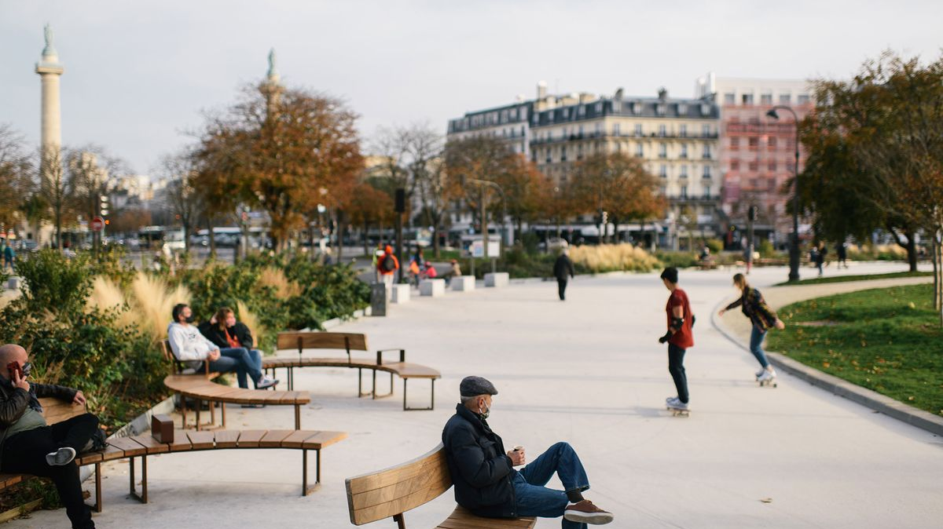
MAKE
(Name of your city)
A 15-MINUTE CITY
A proposal by (YOUR GROUP)
With support from (Your school district)
and (anyone else you can get support from)

Slide 2
Climate Change
The Biggest Crisis of Our Time
We have 6 years to half emissions, yet they are still rising – so they haven’t even begun the decline
Canada is not committing to decrease oil and gas production – in fact, the opposite is happening!
While the UN and scientists agree that we have the solutions NOW, disinformation and doom and gloom have paralyzed most people, making them just go along with what their government says – so let's lead the way!
Notes:
Qwynn

Slide 3
...the City of (Your City) provided a Framework for its citizens, that helped them not only fight Climate Change, but also get healthier and more connected?
WHAT IF...
Notes:
Luisa

Slide 4
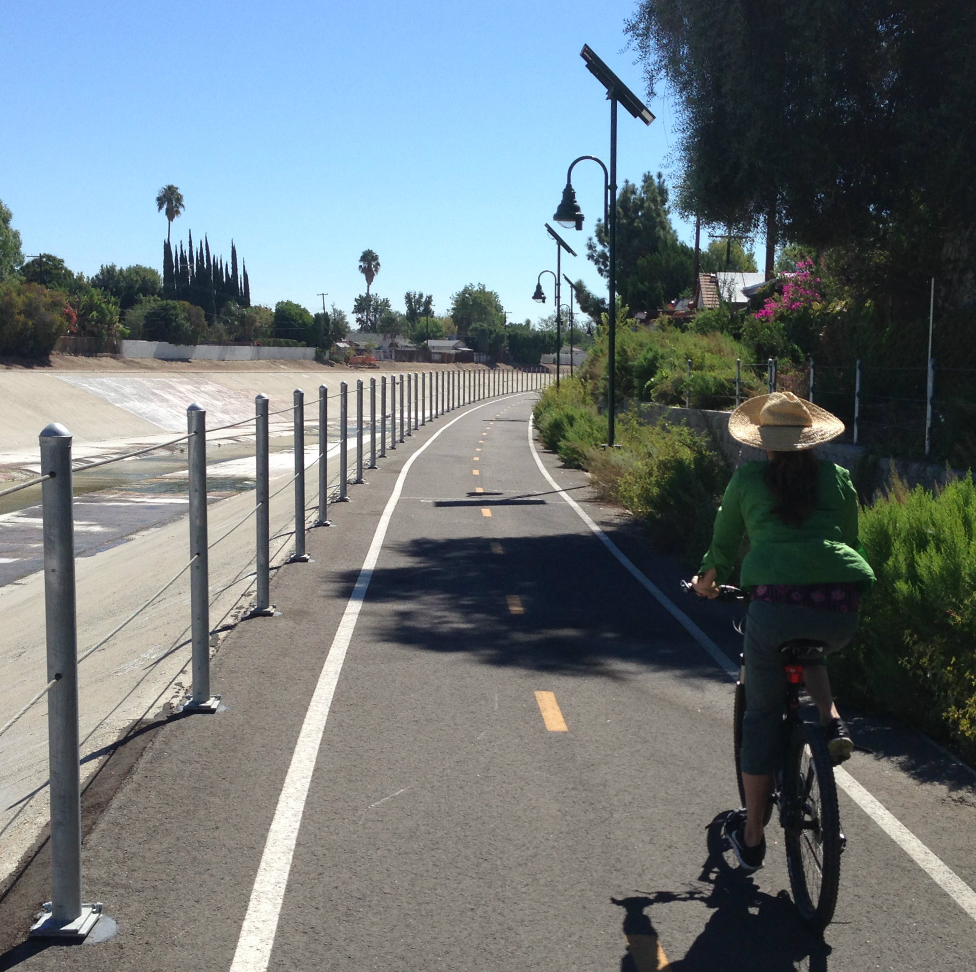
What is a 15-Minute City?
A 15-minute city is a place where everything you need is 15 minutes away! It's also a city that is encouraged to be more car-free.
With the help of a 15-minute city, we can establish a stronger community in our city and connect with nature and each other more.
Notes:
Cole

Slide 5
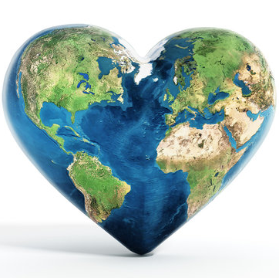
Why do we need a 15-Minute City?
A 15-minute model would help decrease traffic in our City and decrease the impact on our roads.
Our City is already dedicated to planting more trees and adding bike lanes (or another improvement your city is already doing) the transition to a 15-minute mindset is easily achievable.
Because it is a way to send a message that everyone can help in climate action. Once a 15-minute city is implemented, our city's carbon emissions could decrease tenfold.
Notes:
Brianna

Slide 6
Health Benefits
Walking and biking stimulate and improve health. A gorgeous landscape and crisp air is perfect for citizens.
Mental health plays a factor in a 15-minute city as well. Instead of being cooped up in a car, citizens can experience and appreciate their city.
Notes:
Lucia

Slide 7
Protecting the people
Each year 1.35 million people are killed in motor accidents.
Every day 3700 people are killed in motor accidents.
Think about how long it would take for some people to get to the hospital or how long it takes first responders to get to their destination. In a 15-minute city the ride to or from the hospital, fire station and police station would be so much faster. More lives would be saved.
Notes:
Hazel

Slide 8
Things we would need to encourage a 15-minute city!
Notes:
Hazel

Slide 9
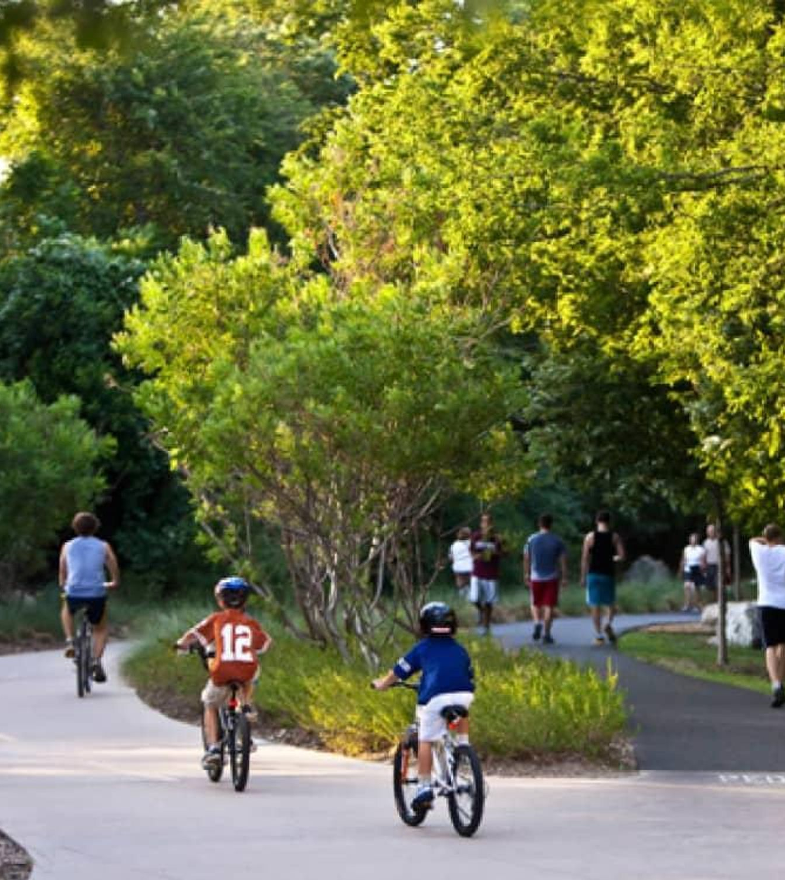
More trees and plants
If we added more trees and foliage along the roads, people feel more comfortable with biking in the sun and rising temperatures.
It also will give people a sense of security and comfort.
Nature is scientifically proven to make people happier, and so if we added more plants and trees, it would help our community get along better and make more people happy.
Notes:
Eri

Slide 10
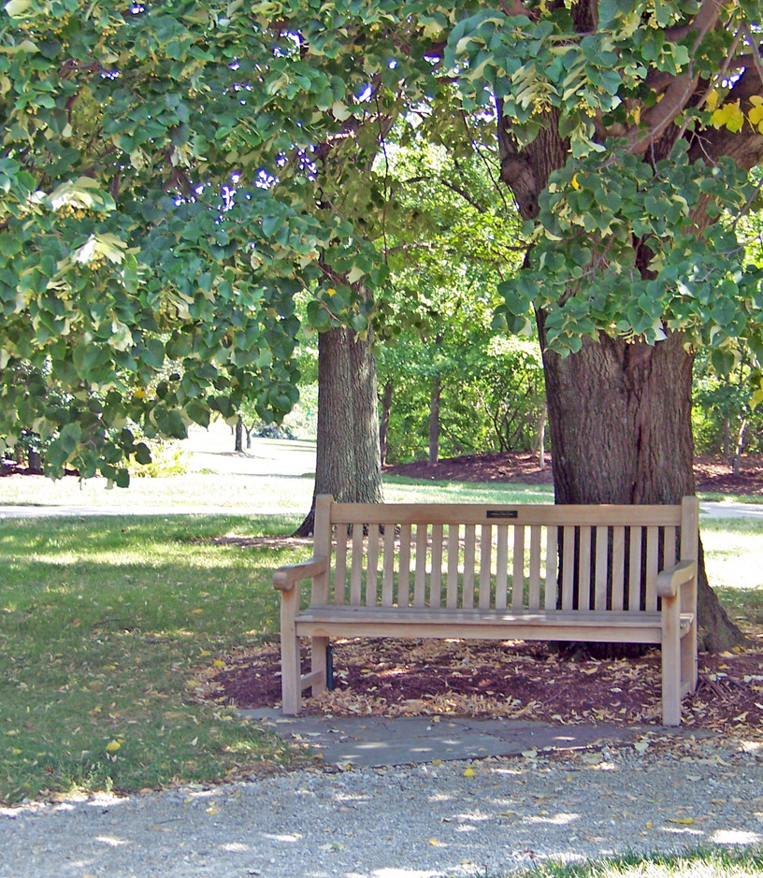
More Benches
Adding more benches away from the City centre could be helpful to a 15-minute city because when people are biking, they like to stop and rest.
People also think that walking or biking will make them tired, so if we put more benches, they know they will have a chance to take a break and be more likely to try.
Notes:
Eri

Slide 11
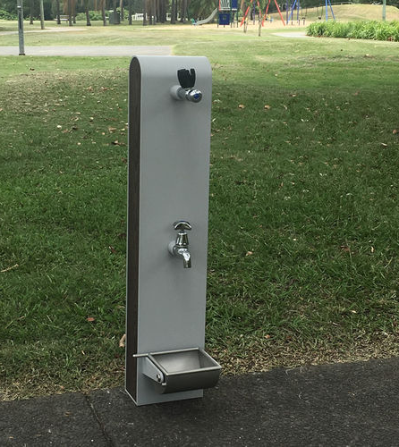
More Water Fountains
With our ever-increasing heat waves due to climate change, it is important to keep citizens hydrated as they are out and about.
Most will probably not have a big, nourishing water bottle with them 100% of the time, which is why it's crucial for many more water fountains to be installed, close, convenient, and clean!
They should be installed on busy roads as well as less-busy tracks, to encourage usage.
Notes:
Yael

Slide 12
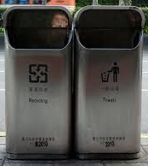
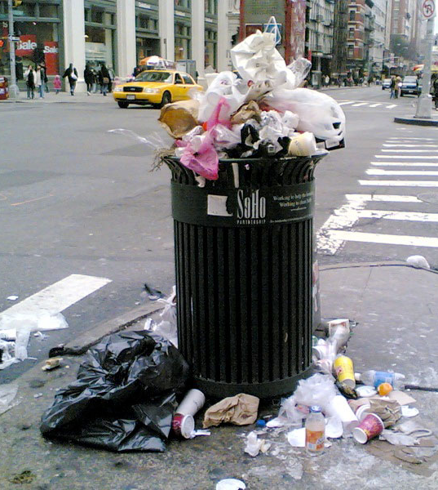
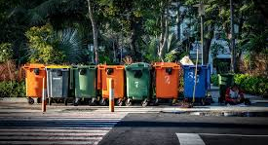
More Trashcans and Recycling Bins
❌
✔️
Bins for disposal are vital for the 15-minute establishment in our own city.
Naturally, citizens do not have places to put their waste and are usually discouraged by the lack of trashcans. They end up dropping it on the streets.
To keep our city clean, there should be more waste bins everywhere as well as recycling bins next to the garbage bins.
✔️
Notes:
Yael

Slide 13
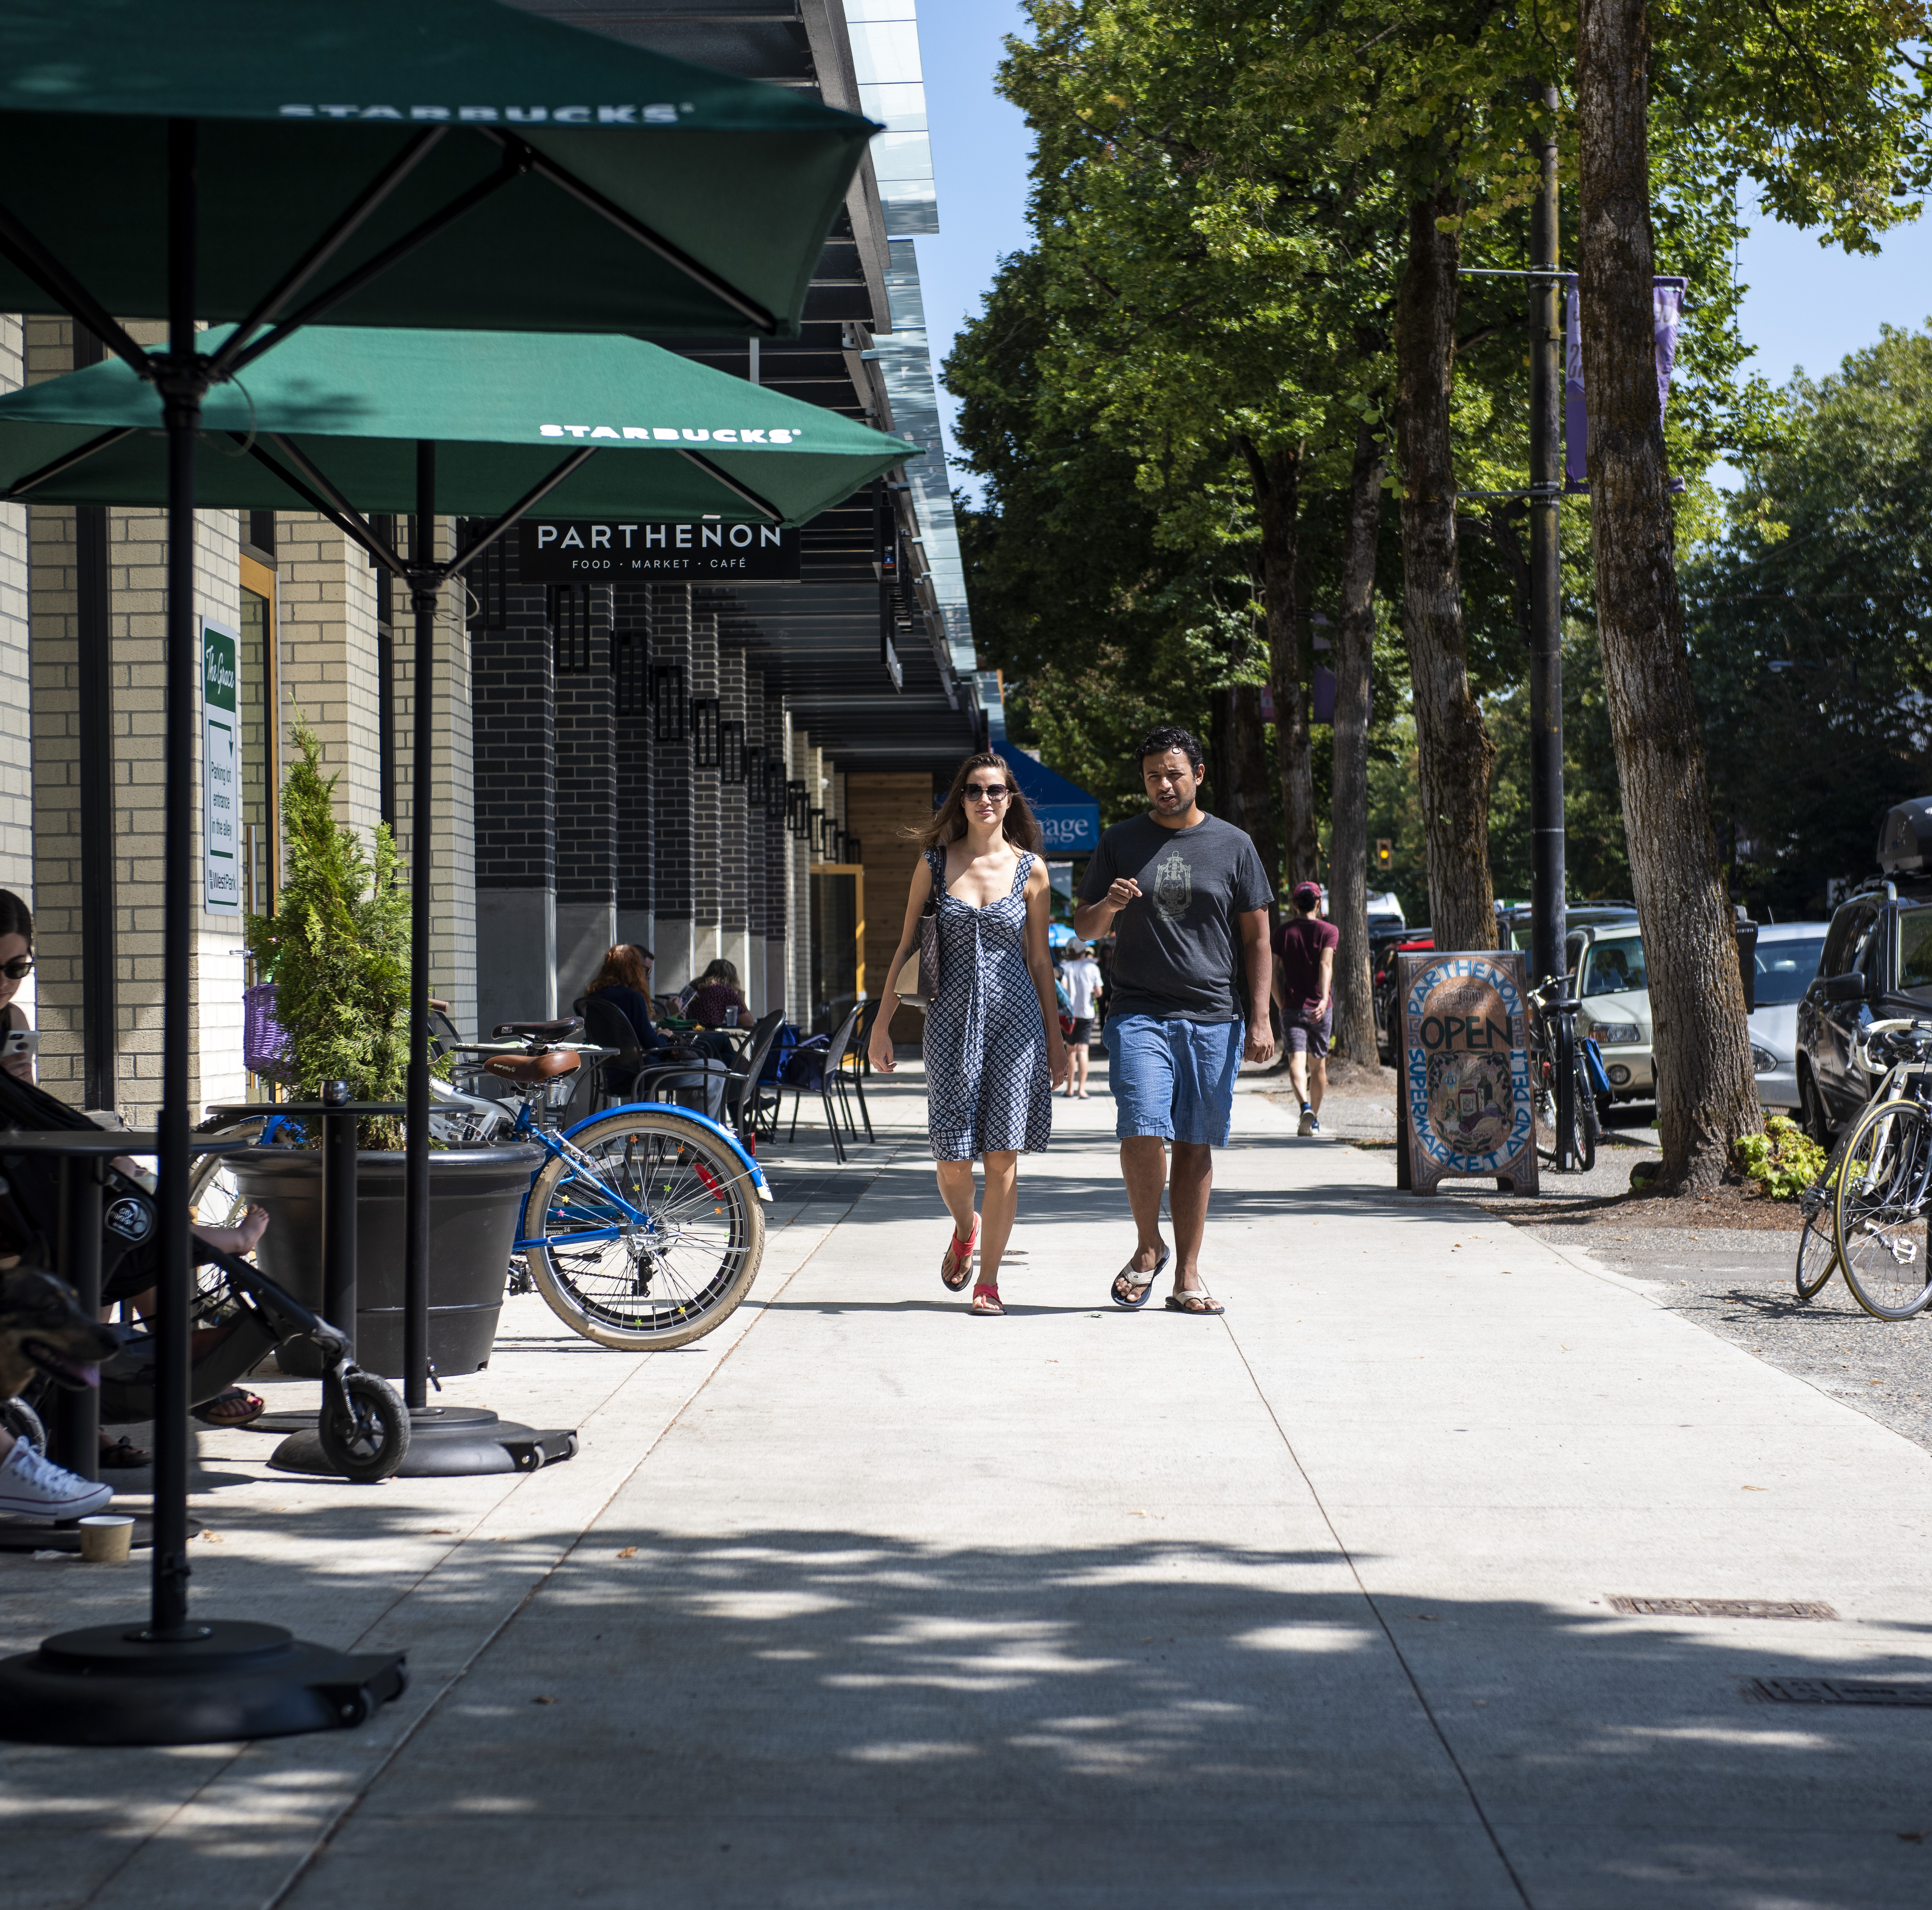
Wider Sidewalks, as Well as Adding More Sidewalks on Neighborhoods Away from City Centre
It is important to focus on the whole city, including side roads, so that it is possible for people to walk easily and safely if they choose to.
This would be very important in terms of accessibility and helping people with wheelchairs.

Slide 14
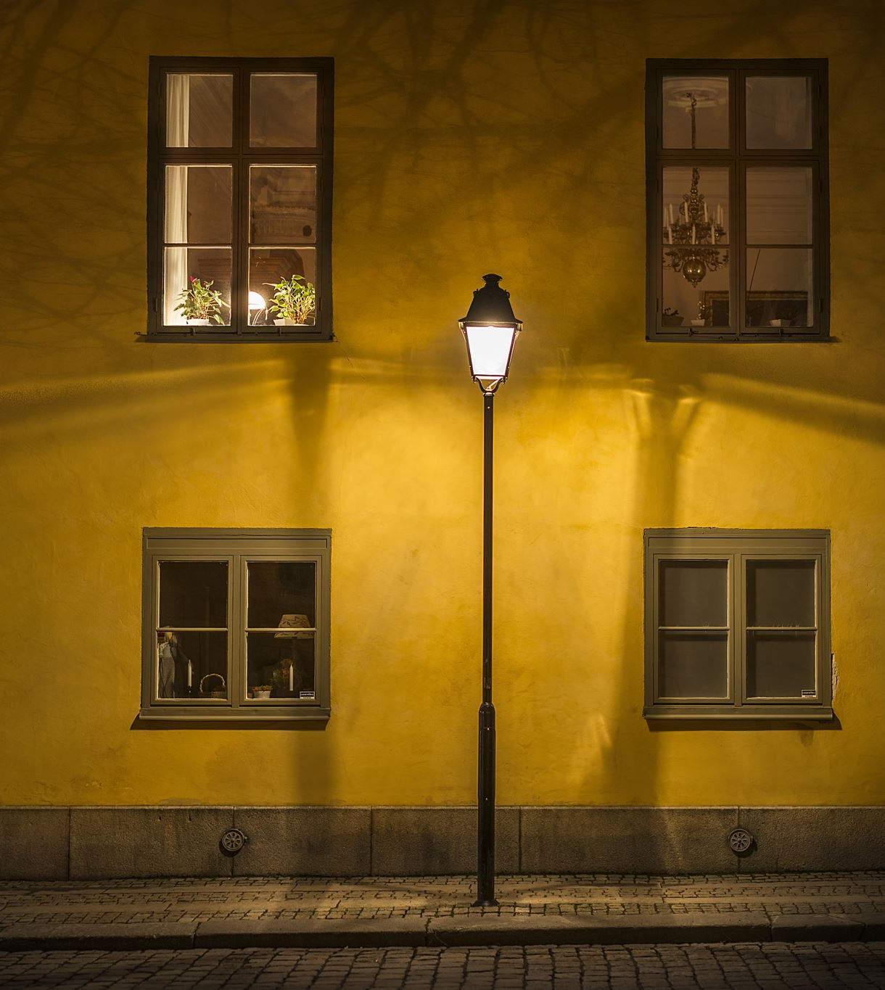
More Streetlights
This would make the City safer and more comfortable for pedestrians and bikers.
Streetlights should not only be installed in areas that are close to the centre, but connecting our City’s neighborhoods through pathways that are cyclist and pedestrian-safe.

Slide 15
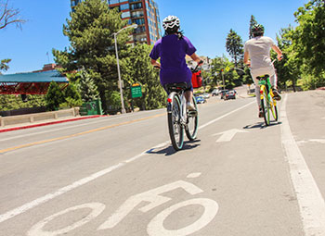
Bike Lanes
It would be best to make more bike paths to central places in the cities, like malls and work buildings so that people can ride their bike regularly.
Also make the existing bike lanes safe all over the city – by adding a physical separation between the bike lane and the car lane.

Slide 16
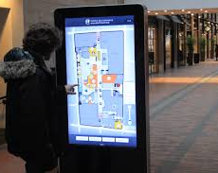
Bike Lane Maps
They would look like this but with bike lanes instead.
It is very important to have maps because people complain that the bike paths are too confusing, so if we put up big easy to understand maps, it will help people feel more confident in biking in the city, and if they feel more confident, they will feel more encouraged to bike and this will help create a car free city.
Located in crucial intersections, these would make it easier for a person riding a bike on a bike lane to find out where the bike lane continues.

Slide 17
More Bike Racks
More bike racks around the City – so that people who are biking can take breaks and so that you can park your bike if you want to go somewhere where you can't take your bike inside (like a store or work).
Permanent bike locks on busy places would be a good idea.

Slide 18
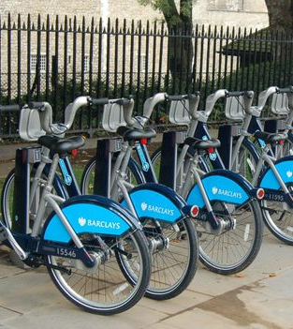
Bike Check-outs
We need a few strategic spots where people could either check out a bike or rent one.
A system with bike cards and tapping or a pole-less, smartphone-based system might be a good way to do this. Bike rentals are extremely important for our proposal because when people want to bike to places like work, they don't because they don’t feel like paying and taking care of their own bike.
If we do these rentals, then people will be encouraged to bike more often. Perhaps they may even discover that they like biking and buy their own.

Slide 19
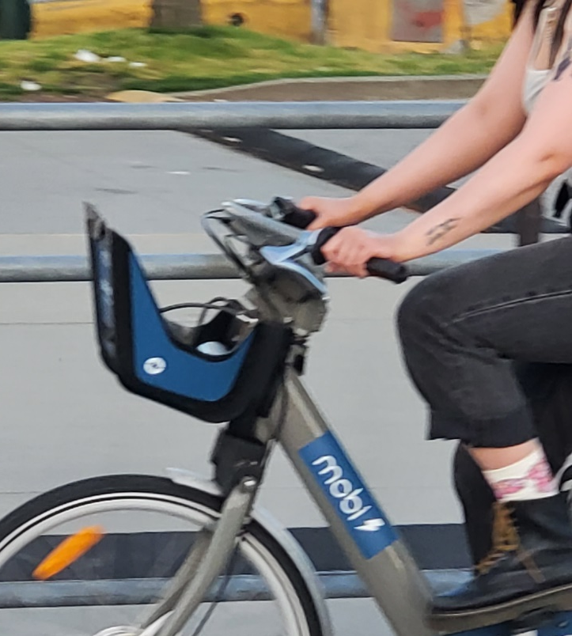
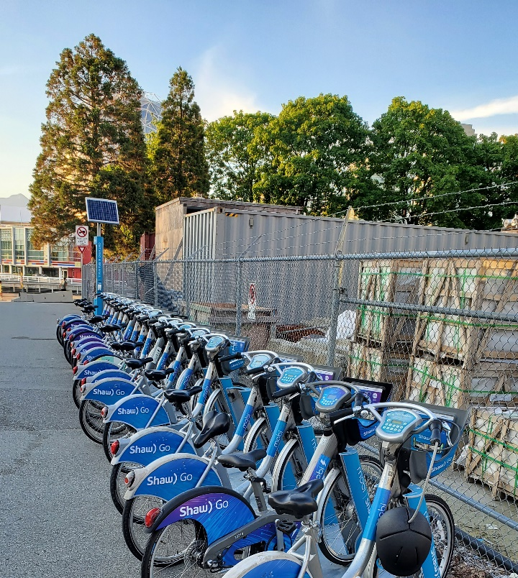
Mobi Bikes – Vancouver Sets a Precedent
Vancouver has implemented a wonderful bike rental system that has pretty much everything we are suggesting.
This is an example of a big city doing the right thing!

Slide 20
Better Bus Service
While the City is not to blame for our spotty service, it is necessary to advocate for the expansion of service for our bus system, increasing frequency and service area which is a known concern for the City (please change to your particular city’s situation).
We have increased our population, but the bus system has not changed.
The City also should pressure the system to provide free transit for students up to the age of 18. On field trips, often half the class has to pay while the other half doesn’t. (again, make sure this makes sense to your city)
This is arbitrary and wrong.
Notes:
Leo

Slide 21
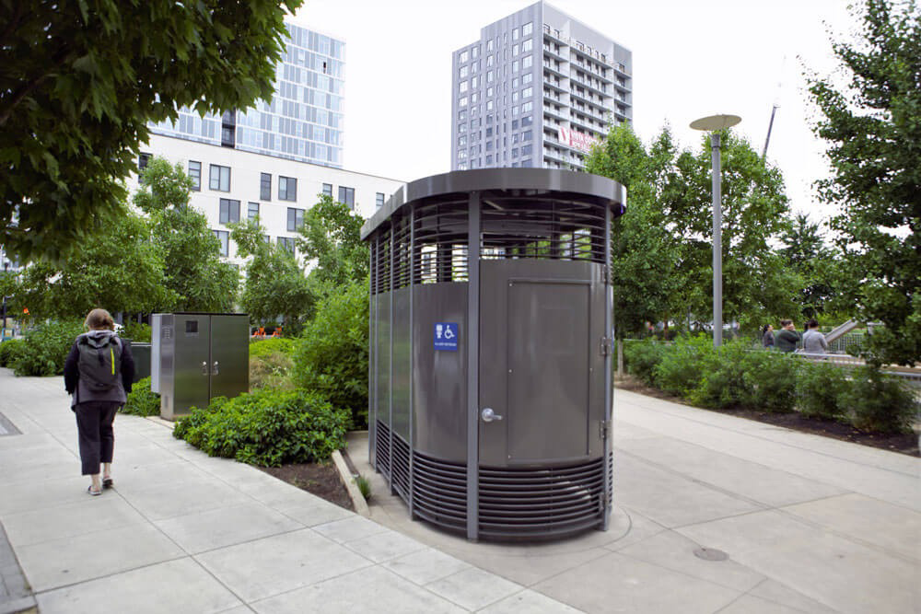
More Public Washrooms
To quote the Tyee, real cities give their people places to pee.
We can't expect people to walk in our city if there is nowhere to go when they need to use the washroom!
Residents and visitors to our City should be able to stay out and about for longer periods of time.
We also need more frequent cleaning to existent bathrooms, as it is often impossible to use them due to their state.
Notes:
Leo

Slide 22
More Community Garden Spaces
They help people connect with nature by growing their own vegetables, as well as connecting with each other in the community. This may require free educational programs so people can learn how to garden.

Slide 23
Playgrounds
Upgrade playgrounds around town to bigger, more active playgrounds, so kids of all ages can feel like being outside and playing, as well as adding even more outdoor fitness equipment in parks and other public spaces to encourage healthy living.

Slide 24
Free City-Wide Wifi
Citizens should be able to walk around and feel confident that they are still connected.
Let's make it easier for everyone to work or study remotely!

Slide 25
More Public Art
Public Art adds character to a city; by placing installations throughout the city, you can encourage residents to explore their neighborhoods.
We would need more contests for public art and more options for this to happen.

Slide 26
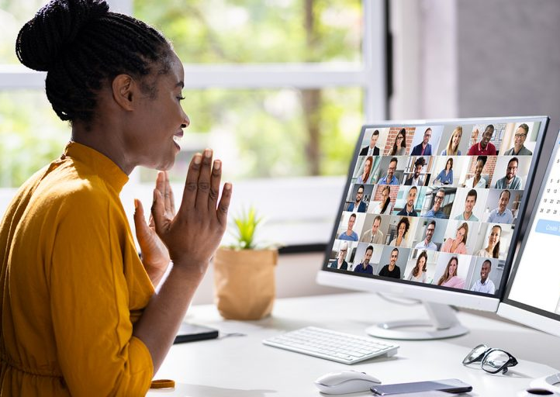
Remote Work
The city's official position would be to encourage remote work whenever possible.
This way people would not have to drive to work.
This would help contribute to a 15-minute city.

Slide 27
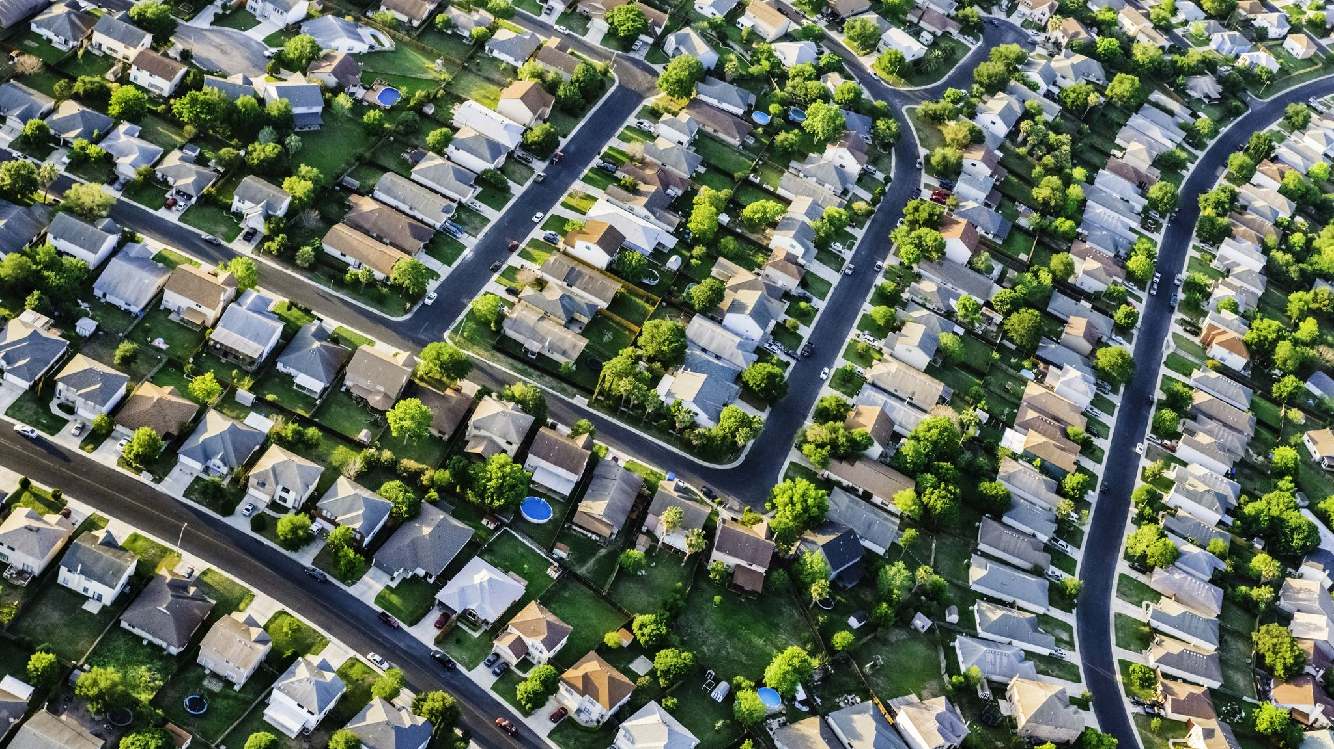
In all of these requests, let there be a focus on Improving lower income neighborhoods, making those safer, more walkable and more attractive!

Slide 28
How to avoid pricing people out of their homes
Start work on areas that are not already expensive, so these areas become more attractive
Put benches and nice trees and plants and lights on areas that are far away from downtown
Focus on making a "walking web" where there are benches, extra lights and a nice vibe in core streets, so all the more developed areas of the city would be connected

Slide 29
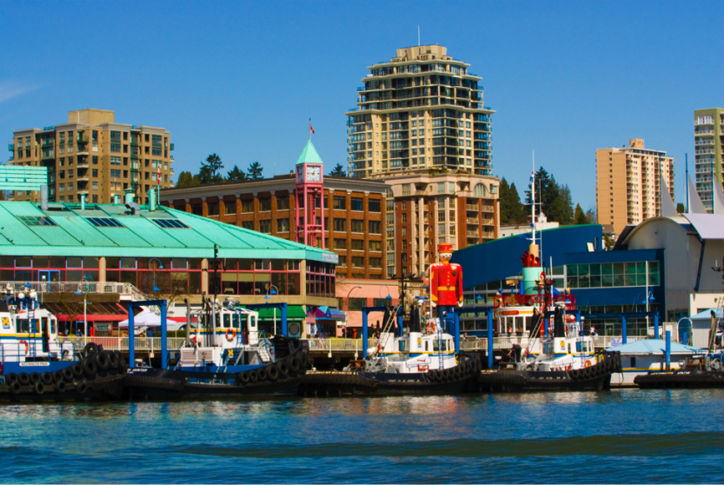
The MAIN Thing... Education!
The City would have to educate the people of (Your City) regarding 15-minute Cities and the changes required to make it happen.
It is an easy way to shake people up and make them reevaluate all their choices...
...because our choices become our behaviours, and our behaviours are destroying the Earth.

Slide 30
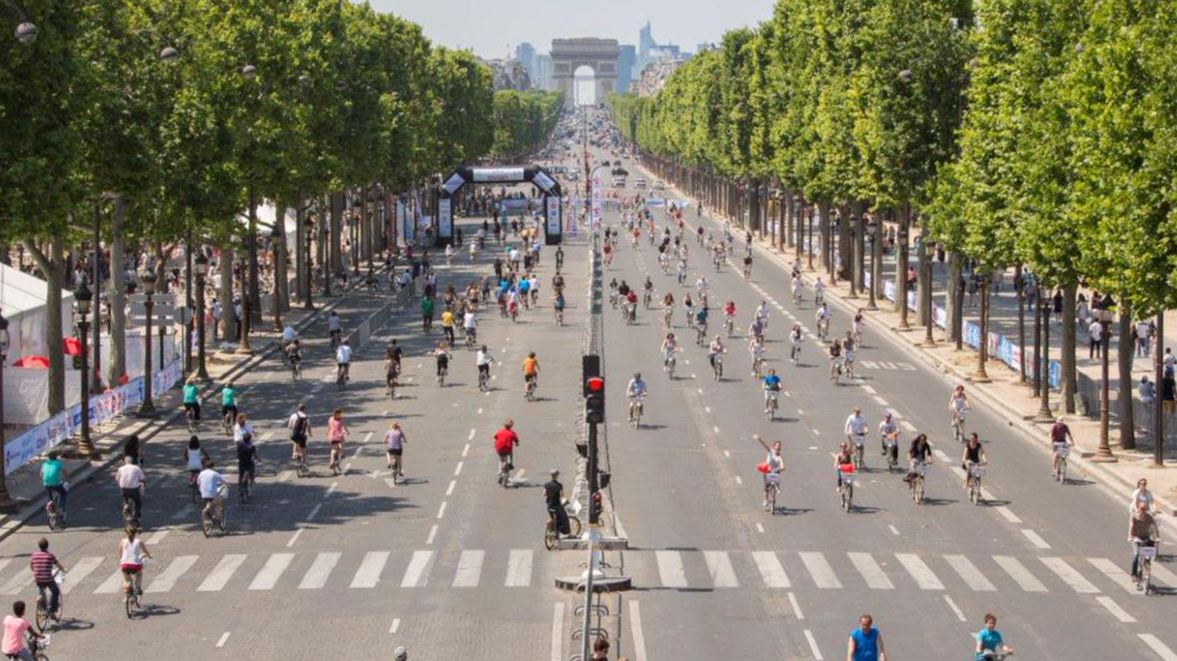
“A developed country is not a place where the poor have cars. It's where the rich use public transportation.”
― Gustavo Petro
The future is NOW!
THANK YOU!

