Slide 1
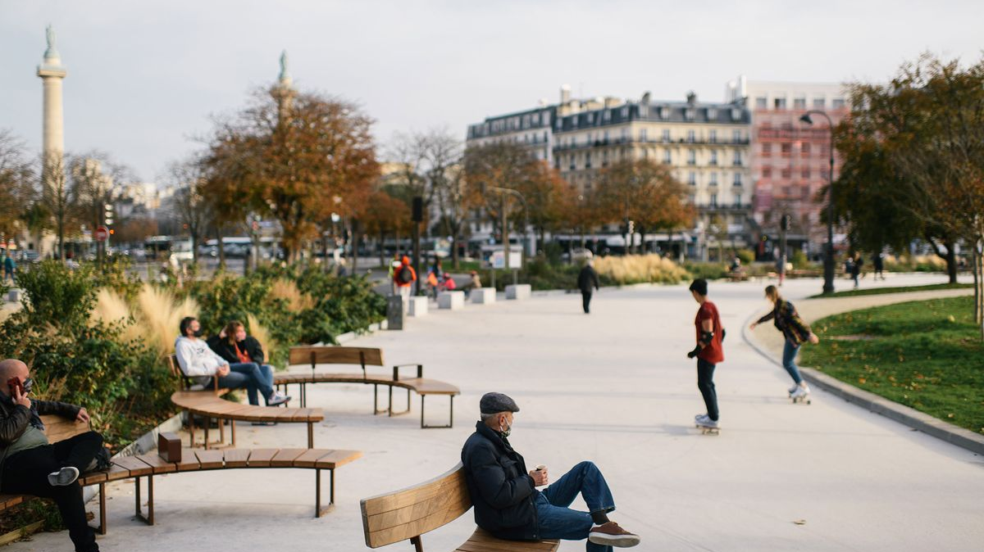
MAKE
(NAME OF YOUR CITY)
A 15-MINUTE CITY
A proposal by (YOUR GROUP)
With support from (Your school district)
and (anyone else you can get support from)

Slide 2
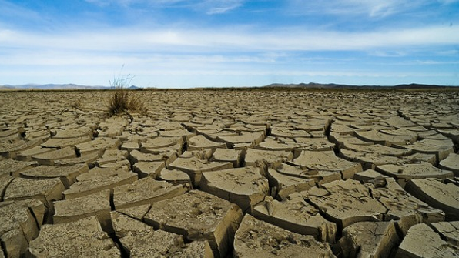
Climate Change...
The Biggest Crisis of Our Time
Notes:
Qwynn

Slide 3
WHAT IF...
...the City of (your city) provided a Framework for its citizens?
We Could lead the way!
Notes:
Luisa

Slide 4
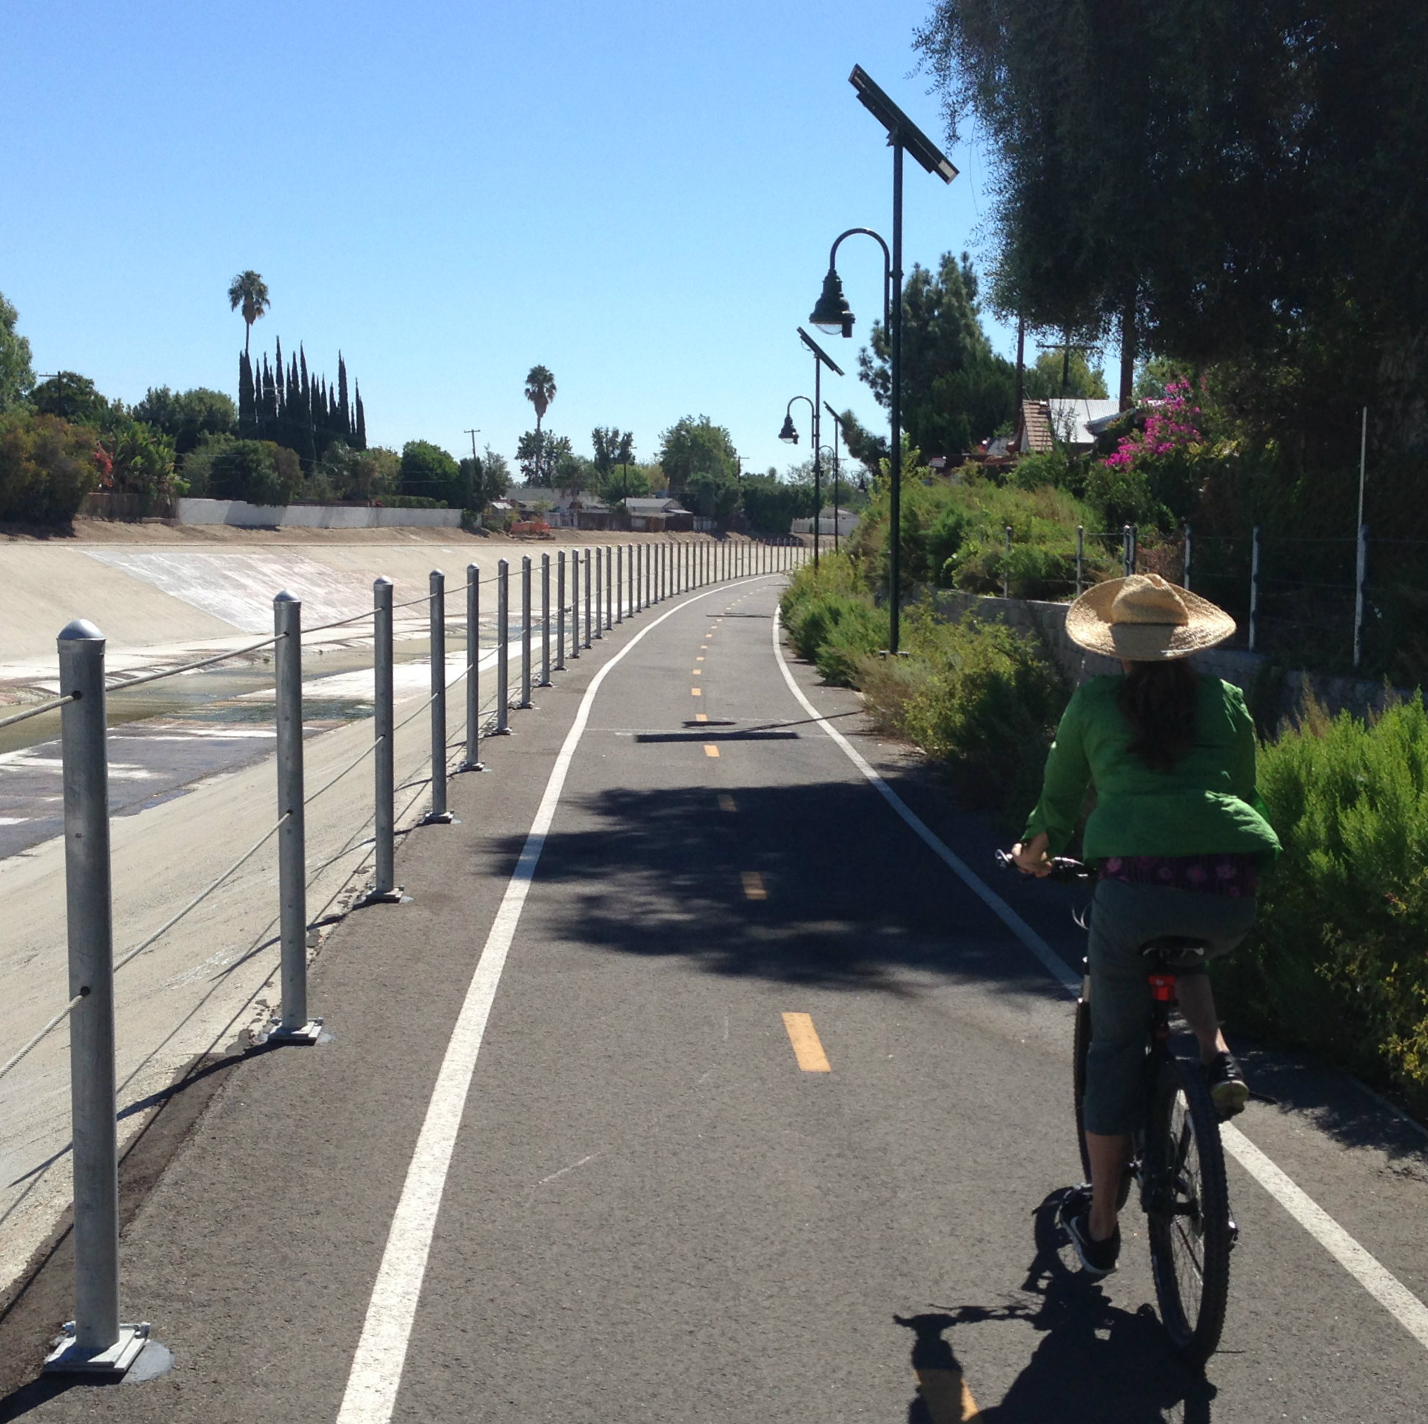
What is a 15-Minute City?
A 15 MINUTE CITY is a place where everything you need is 15 minutes away! It's also a city that is encouraged to be more car-free.
Notes:
Brianna

Slide 5
Why do we need a 15-Minute City?
A 15-minute model would help decrease traffic in our City.
This is a way to send a message that everyone can help in climate action.
Notes:
Lucia

Slide 6
Health Benefits
Walking and biking stimulate and improve health, both physical and mental.
Notes:
Hazel

Slide 7
Protecting the people
Each year 1.35 million people are killed in motor accidents.
Every day 3700 people are killed in motor accidents.
A 15-minute city would help emergency vehicles save lives.
Notes:
Yael

Slide 8
Things we would need to encourage a 15-minute city!
Notes:
Abigail

Slide 9
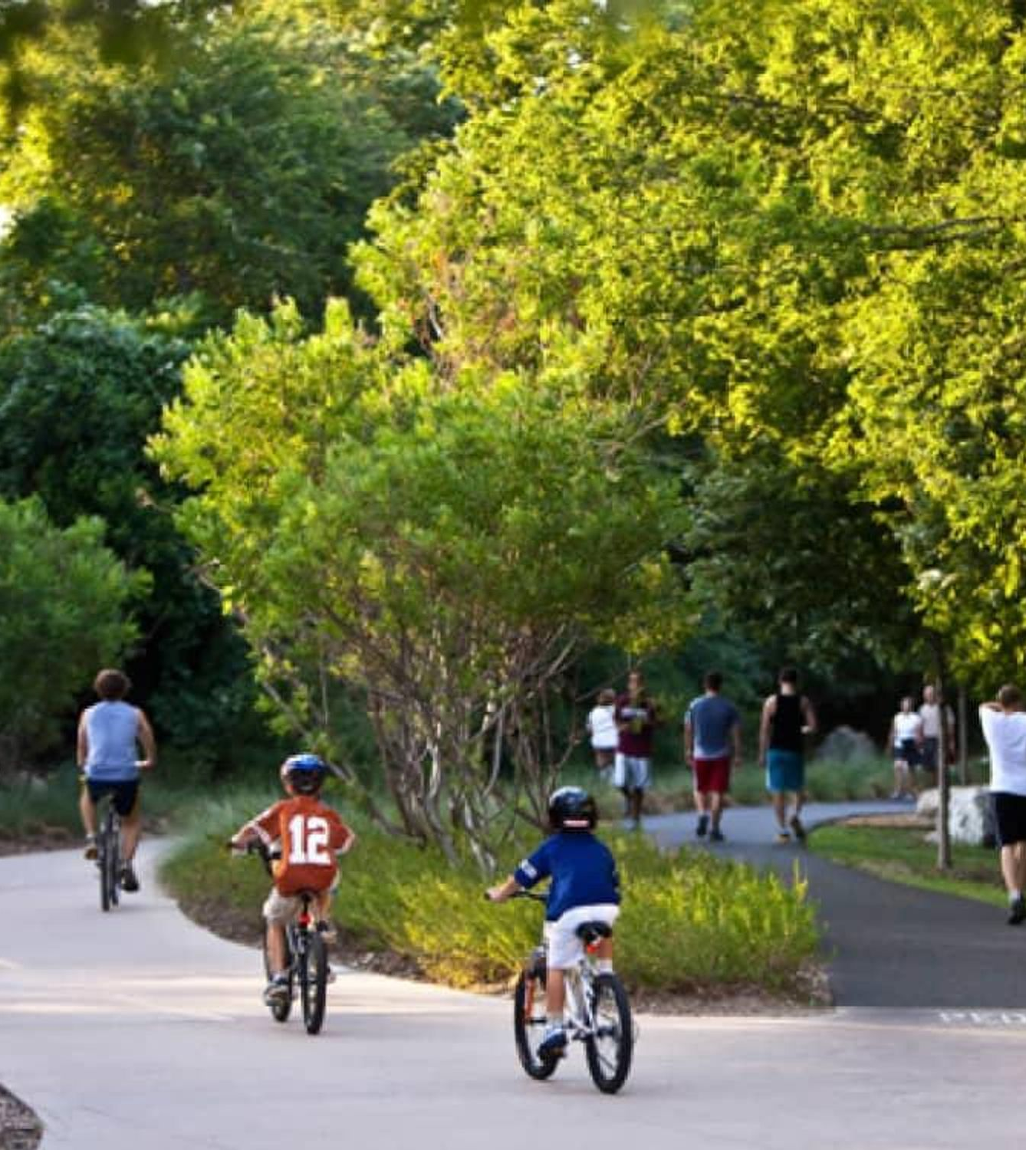
More trees and plants
Notes:
Eri

Slide 10
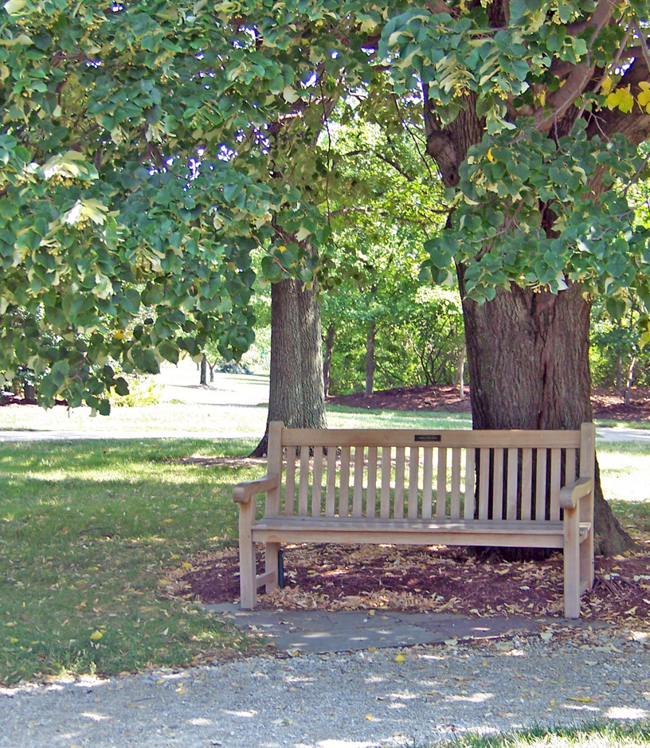
More Benches
Notes:
Eri

Slide 11
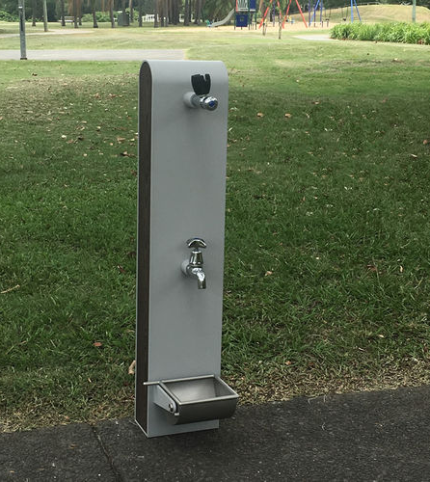
More Water Fountains
Notes:
Brianna

Slide 12
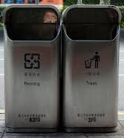
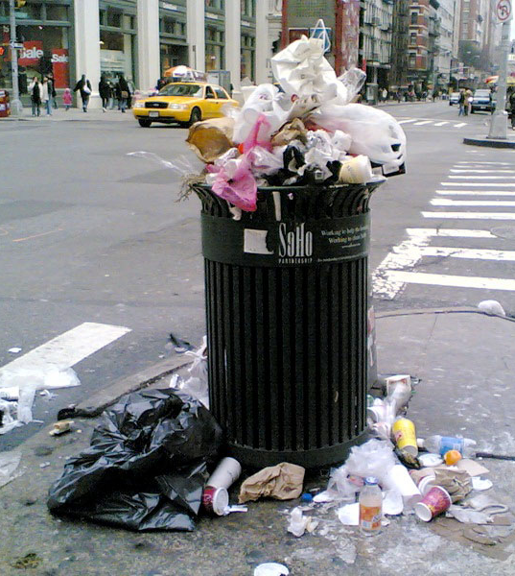
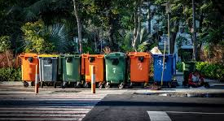
More Trashcans and Recycling Bins
❌
✔️
✔️
Notes:
Hazel

Slide 13
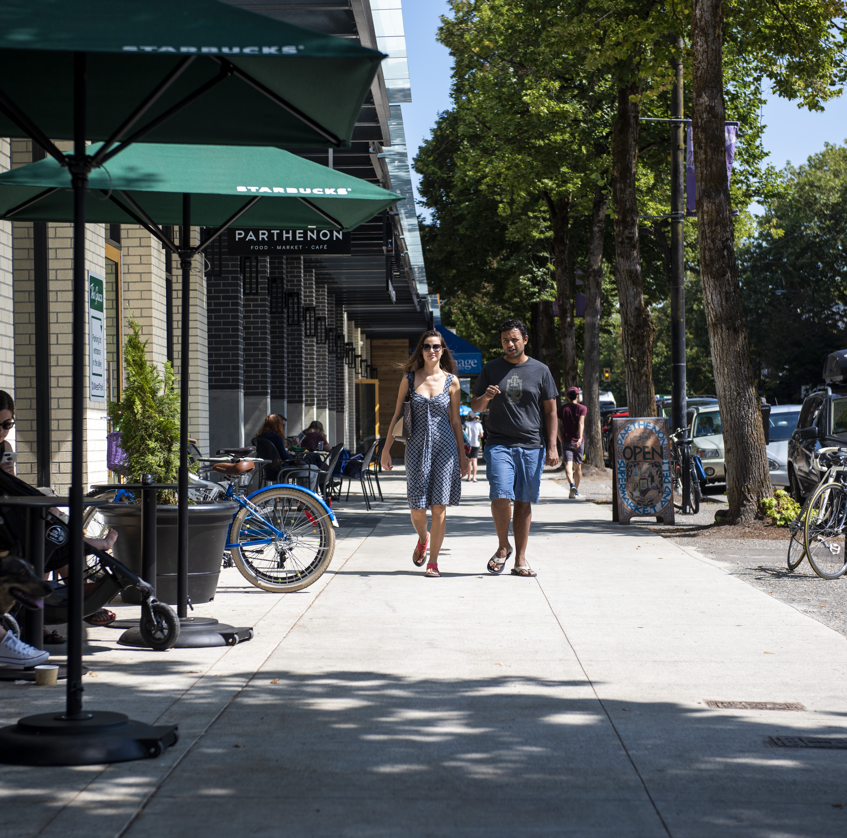
Wider Sidewalks, as Well as Adding More Sidewalks on Neighborhoods Away from City Centre
Notes:
Cole

Slide 14
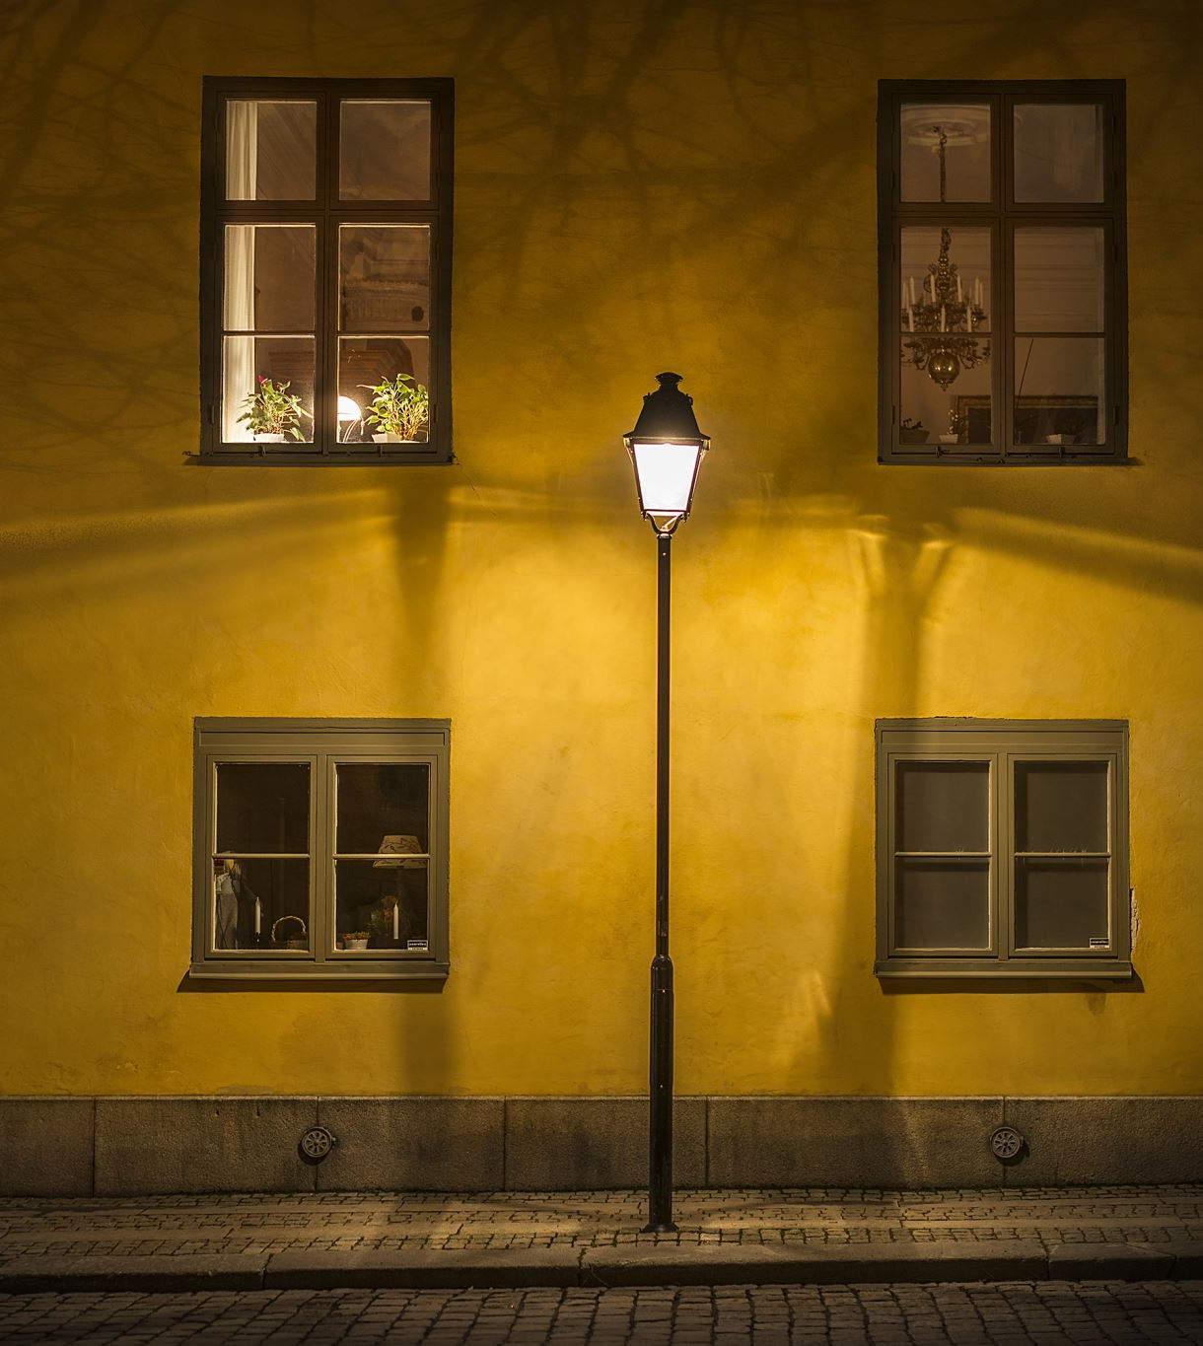
More Streetlights SAFETY!!!
Notes:
Cole

Slide 15
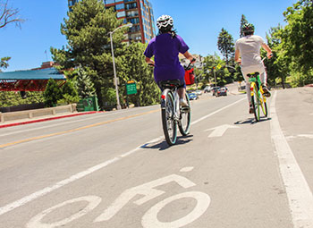
Bike Lanes
MORE!
Please – consider a physical separation between the bike lane and the car lane.
Notes:
Lucia

Slide 16
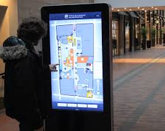
Bike Lane Maps
They would look like this but with bike lanes instead.
Located in crucial intersections, these would make it easier for a person riding a bike on a bike lane to find out where the bike lane continues.
Notes:
Hazel

Slide 17
More Bike Racks
Notes:
Lucia

Slide 18
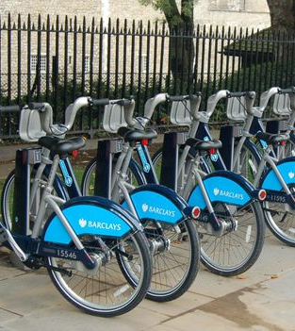
Bike Check-outs
Notes:
Yael

Slide 19
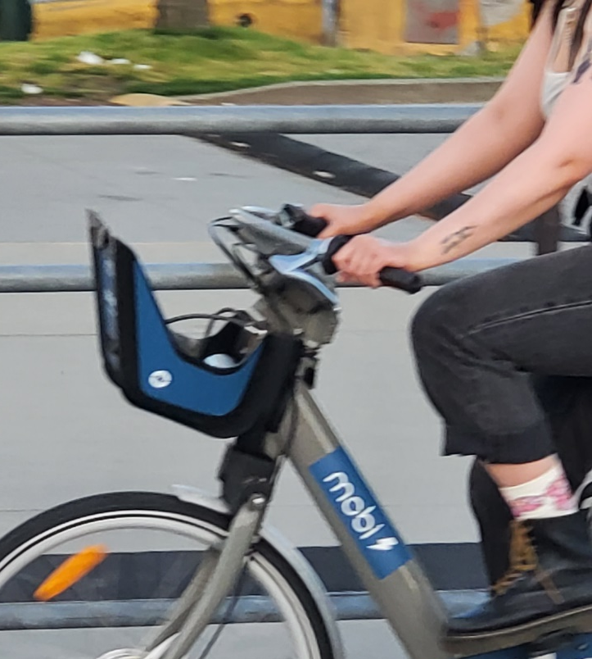
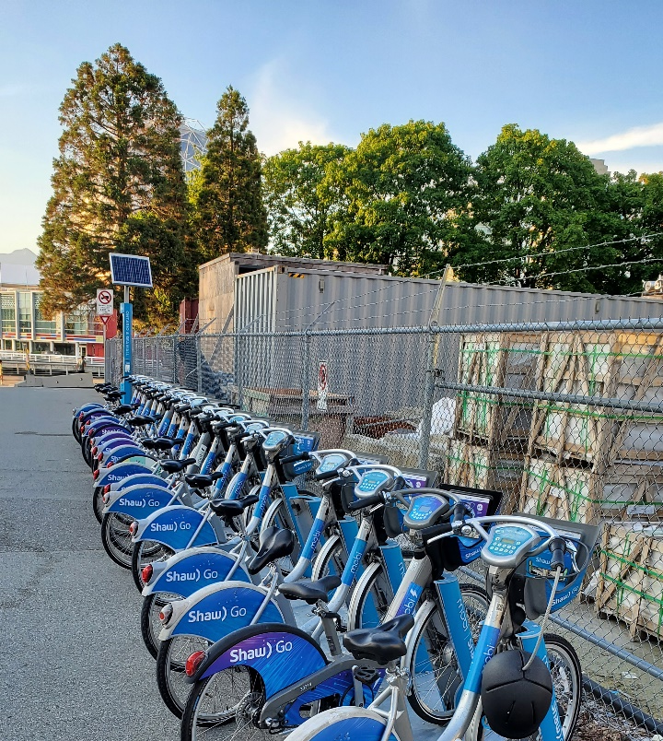
Mobi Bikes – Vancouver Sets a Precedent

Slide 20
Better Bus Service
Increase frequency and service area as well as pressure the system to provide free transit for students up to the age of 18.
Notes:
Leo

Slide 21
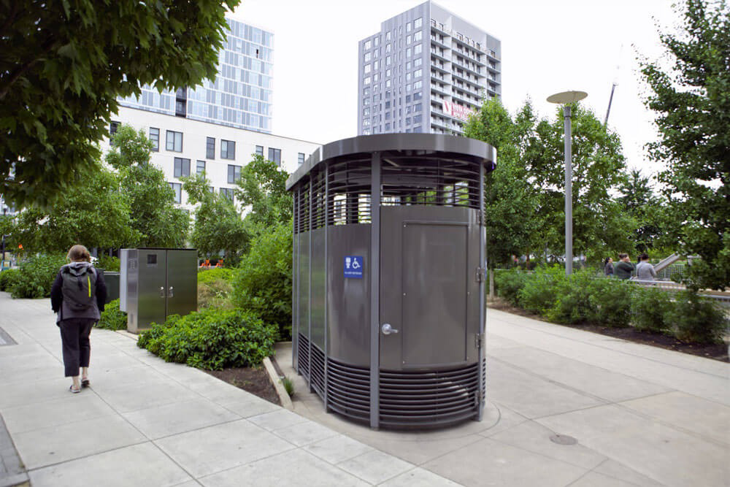
More Public Washrooms
Notes:
Leo

Slide 22
More Community Garden Spaces
Notes:
Luisa

Slide 23
Upgrade Playgrounds
As well as adding even more outdoor fitness equipment in parks and other public spaces to encourage healthy living.
Notes:
Lucia

Slide 24
Free City-Wide Wifi
Popular areas, such as community centres, parks and commercial areas, should offer free wi-fi. It would not be hard to expand our service.
Notes:
Cole

Slide 25
More Public Art
Notes:
Eri

Slide 26
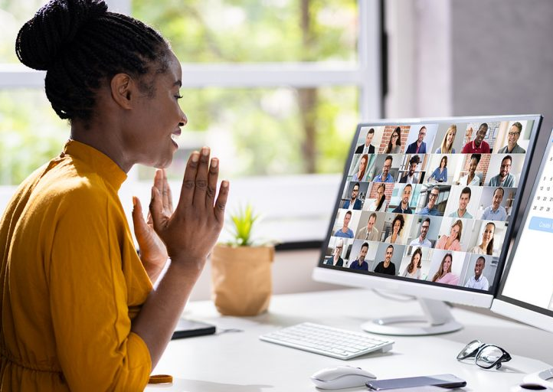
Encourage Remote Work
Notes:
Qwynn

Slide 27
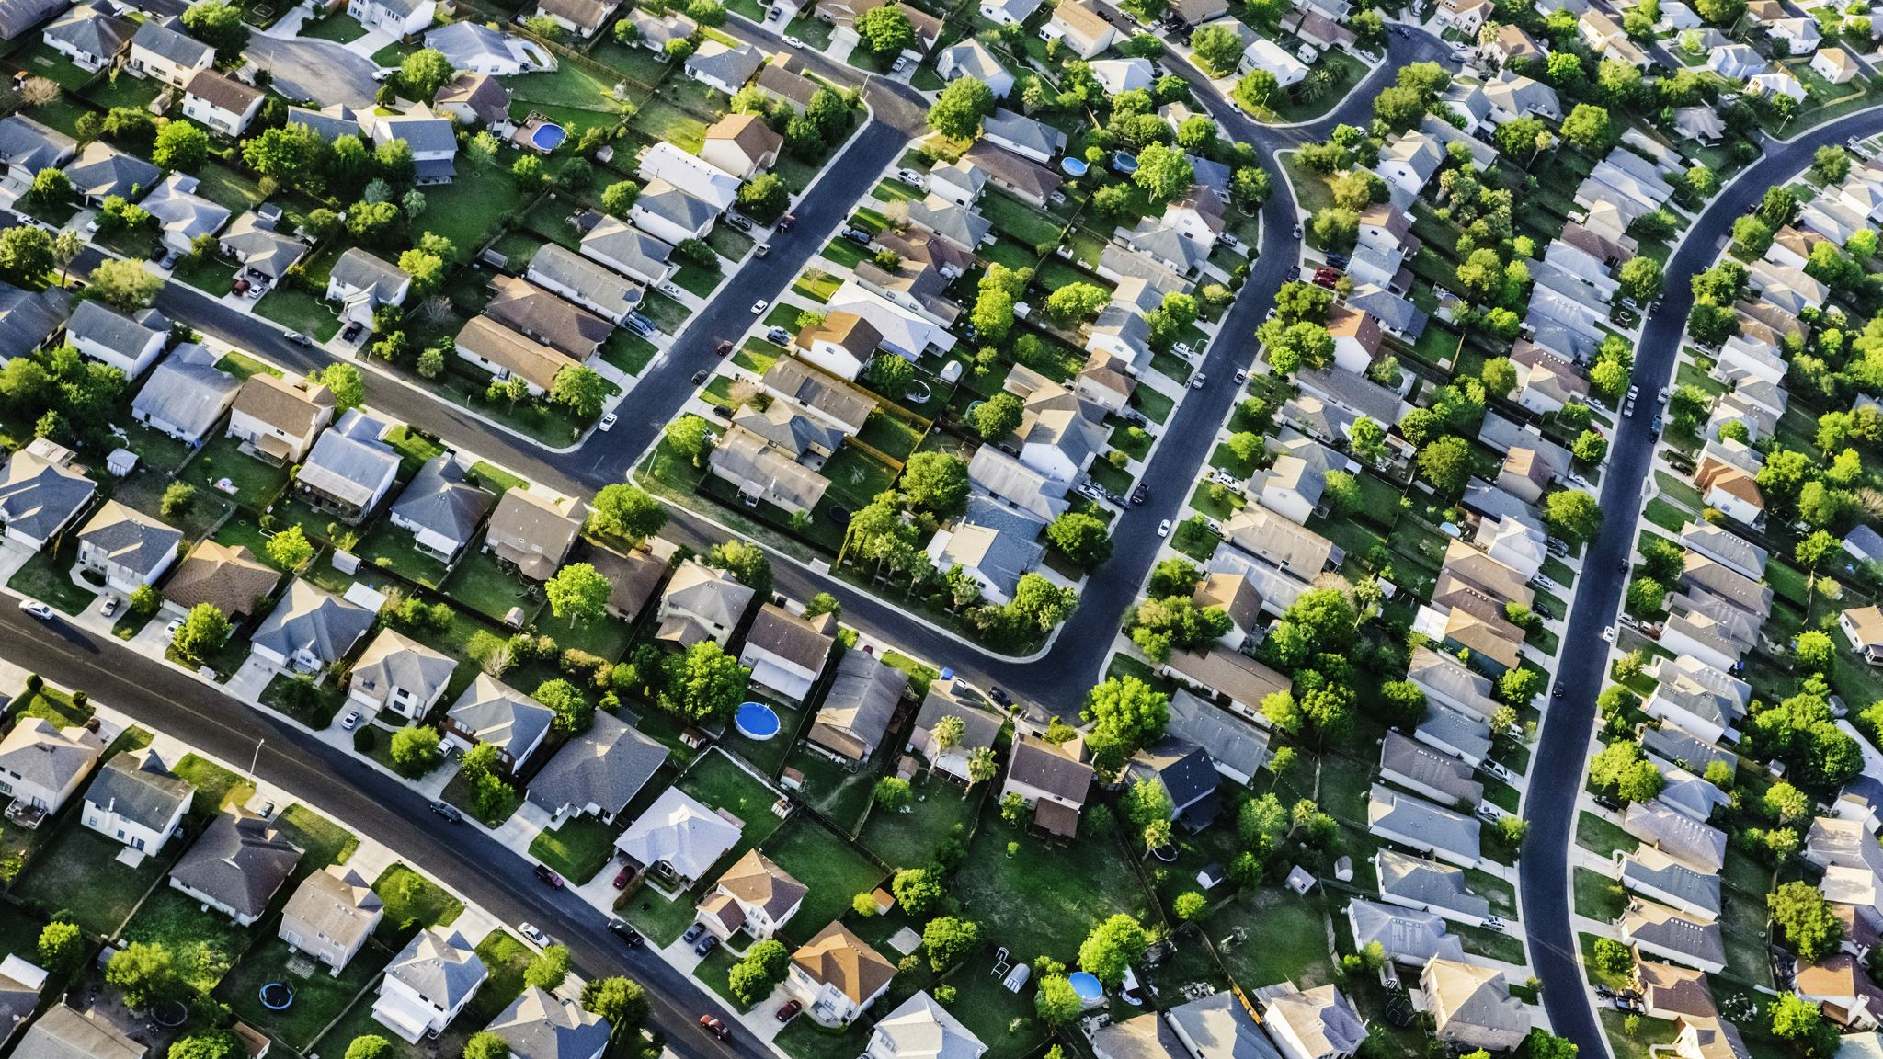
In all of these requests, let there be a focus on Improving lower income neighborhoods, making those safer, more walkable and more attractive!
Notes:
Qwynn

Slide 28
How to avoid pricing people out of their homes
Start work on areas that are not already expensive, so these areas become more attractive
Put benches and nice trees and plants and lights on areas that are far away from downtown
Focus on making a "walking web" so all the more developed areas of the city would be connected
Notes:
Abigail

Slide 29
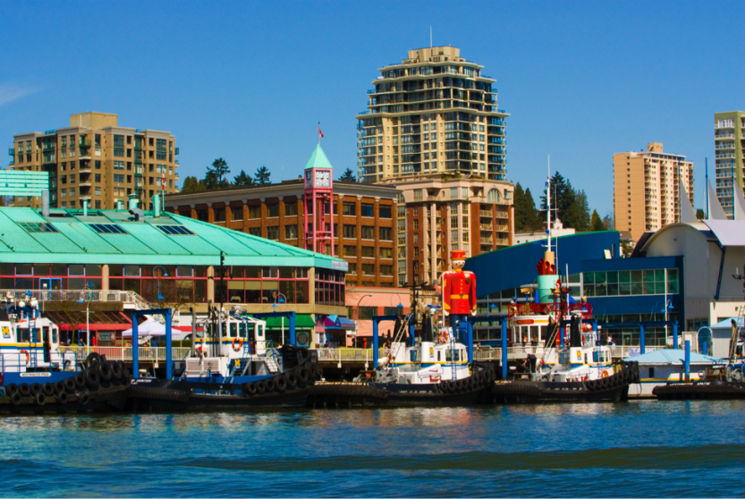
The MAIN Thing... EDUCATION!
Notes:
Luisa

Slide 30
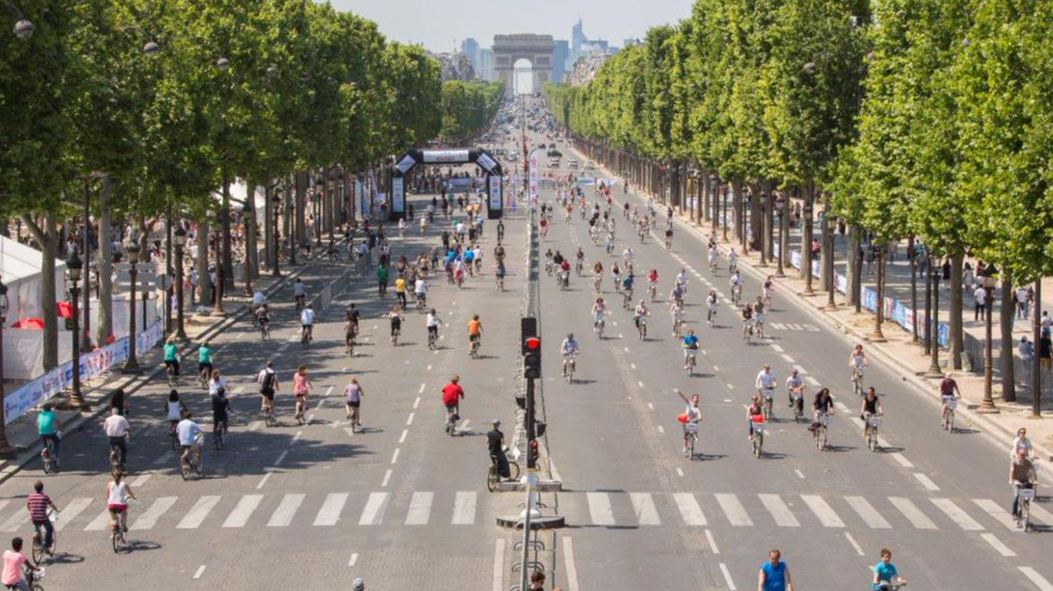
“A developed country is not a place where the poor have cars. It's where the rich use public transportation.”
― Gustavo Petro
The Future is Now!
THANK YOU!

